Slide 1
Input, Integrity and impact
Bhagawan Koirala
Tribhuvan University
katthmandu

Slide 2
Why is Nepal behind?
Lack of Money?
Lack of machines?
Lack of Manpower?
Lack of “Man” power?
All of the above?
Which order?
“Man” power !!

Slide 3
Pick two names from national arena:

Slide 4
Professionalism
Commitment of a physician to the patient: interest of the patient first: no external influence: monetary, political, caste, religion, personal
Commitment to the society: social contract between the doctor and the society
Commitment to the profession: uphold the dignity and prestige of the profession
Physician’s health and well being
Professional identity formation: humane, healthy, positive, proactive and honest
Regulation Concerning the Conduct of Employees of the Civil Service, 2065 B.S. (2009)
Chapter-2
Provisions Relating to Official Conduct
Official Status to be Maintained: (1) A Civil Servant shall, in discharging his official duties, always keep in mind the larger interest of the nation and the people and subject oneself to the existing laws.
Necessity to respect the Profession: (1) A Civil Servant shall always make efforts to make his or her profession reputed and dignified by paying respect to the profession.

Slide 5
General qualities of a Team leader
Common Sense: ➢ Judgment: displays critical thinking skills, common sense, and decisive
Consistency: ➢
Clean: ➢Ethics: Applicant displays honesty, integrity, and ethical behaviors.
Empathy: considerate, sensitive, and tactful in response to others
Truthfulness: in daily life and in profession
Courage: ➢
Competence: ➢
Compliance: ➢
Conduct of Employees of the Civil Service, 2065 B.S.:
Knowledge of Law and Compliance: (1) A Civil Servant shall have, as a minimum, the knowledge of all the laws that are pertinent to his or her work.

Slide 6
Heart and the mind game
Personal interest
Personal Professional interests
Public interest
Set your expectations right
Code of Conduct of Employees of the Civil Service, 2065 B.S.:
Making Efforts to develop one's capacity: A Civil Servant shall always make efforts to develop his or her professional capacity while at the same time discharging his or her official duties.
OK: To participate in a competition opened to all and to accept a prize, medal, certificate or commendation,

Slide 7
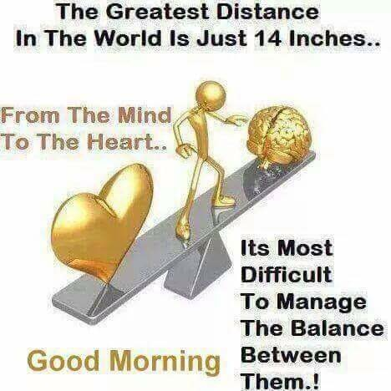
The heart and the mind game

Slide 8
Modus operandi of institutions?
Particularism, personalism partiality
Vs
Universalism-impersonalism-impartiality
Due and Uniform Treatment to be Given: (1) A Civil Servant shall give due and uniform treatment to all without distinction as to caste, creed, religion, language, sex, age, political or social standing, geographical factors, political affinity, access or relation, physical condition, marital status or any of these.

Slide 9
Conflict of Interest, in examples
Private practice
First “bribe” offer
Mathema report and Mediciti
Resignation from Teaching Hospital

Slide 10
Input, integrity and impact
Impact
Integrity
Input

Slide 11
Integrity
Integrity itself is the most effective amplifier of an input
The progress and development is inevitable.
Integrity could be context and sometime Culture based too, but the principle is universal.
Temptation towards all the physical facilities could be the serious challenge, thus one should know to make a balance.
The fine thin line is delicate one, thus be careful. Once broken, its gone.
At least make space for self-reflection, by the end of the day when you are only yourself and recall everything, there should no moment of repaint/ no feeling of guilt.

Slide 12
IMPACT
Results matter, but the processes are equally important
Impacts counts, but perceived impact created without integrity doesn’t last long.

Slide 13
Lesson I have learned
Just do your job better..
Try to improve when you are praised, try to improve when you are criticized..
Most of the things are done by common sense and honest efforts

